Slide 1

WELCOME

Slide 2


01
COURSE: OOP1
02
SECTION:J
03
SUBMITTED TO:
MD. NAZMUL HOSSAIN
(LECTUERER, AIUB)
PROJECT TITLE: JOB WINING CV MAKER.

Slide 3

GROUP NO:7
GROUP MEMBER’S DETAILS:
NAME | ID
SUMAYEA KHATUN | 20-43837-2
ARAFAT AHMED | 20-43580-1
FABIHA ALAM | 20-44096-2
HUMAYRA MARDIA | 20-44108-2

Slide 4

PROJECT OBJECTIVE/ MOTIVATION:
User efficiency
Saves time
Choose the category
Manage your profile & documents
Provides information
Creates a professional-looking resume

Slide 5

Users:
A. Admin
B. Applicant
General
Fresher
Experienced
b. Premium
IT
Banking & Finance
Heath-Care

Slide 6
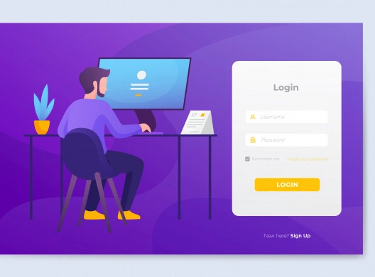
FUNCTIONALITIES
SIGN UP
LOG IN
Admin
Applicant

Slide 7

Sign up(Only for applicant)
Name: ABCD
Age:**
Gender:
Contact no:
E-mail:*****@gmail.com
Password:****
Log in
Admin
User ID: admin
Password:admin
Applicant
User ID: contact no
Password: ****

Slide 8

AFTER LOG IN ADMIN FIND:
Accessibility on the system
Applicant Details
Delete applicant

Slide 9

After Log in Applicant FIND:
Choose Option
Payment (For Premium applicant)
Choose Option
Choose sector
Enter data
View resume/Show details

Slide 10

Select Option (applicant)
General
Premium
Fresher
Experienced
IT
Banking
Health-Care

Slide 11

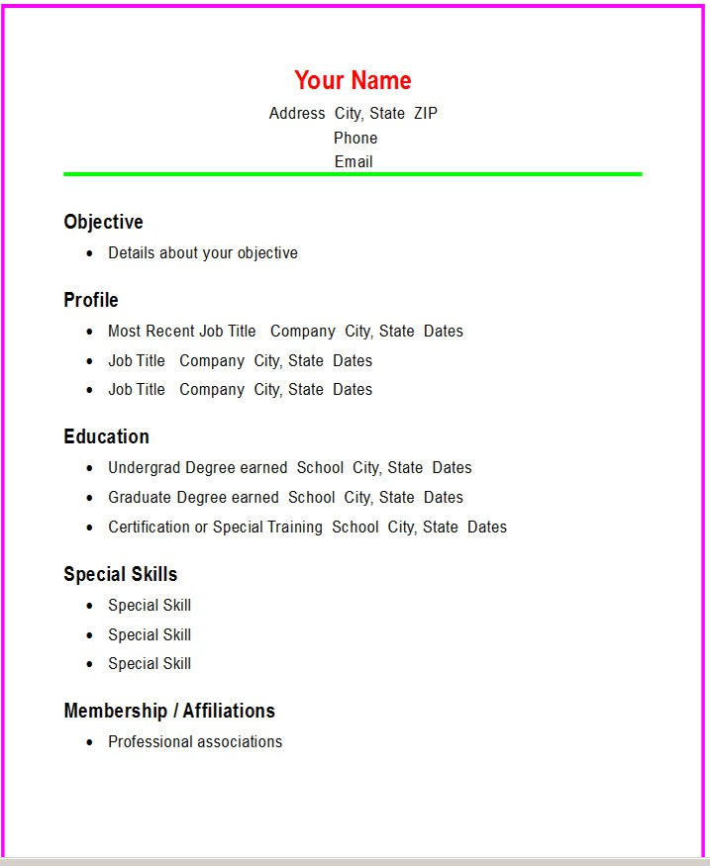
GENERAL APPLICANT
SAMPLE TAMPLATE
Objective
Profile
Education
Skills
Reference

Slide 12



COMPONENTS OF RESUME
(Premium applicant)
SAMPLE TEMPLATE
CV/RESUME
Biographical data
References
Certificates/
Achievements
Objective
Educational History
Skills
Experienced History

Slide 13


BENEFITS:
1.The simplest and most effective tool for resume writing.
2.Applicants can produce professional looking resume easily
3.User documents kept on file for one year

Slide 14

LIMITATIONS:
1.Graphical User Interface can be used.
2.A better payment system could have been created.
3.The quality of premium CV’s could have been made a little better.

Slide 15

PROJECT CONTRIBUTION
Sumayea Khatun
Arafat Ahmed
Choose option , Enter all the details of general applicant
Humayra Mardia
Enter all the details of premium applicant,
View resume
Fabiha alam
Payment
Sign up and log in(Admin + Applicant)

Slide 16

THANK YOU

